Slide 1
Memory Hierarchy Design

Slide 2
Suggested Reading:
Some good materials related to memory Hierarchy and Memory Mapping on the following links:
https://www.gatevidyalay.com/memory-hierarchy-memory-hierarchy-diagram/
https://www.gatevidyalay.com/cache-memory/
https://www.gatevidyalay.com/cache-mapping-cache-mapping-techniques/

Slide 3
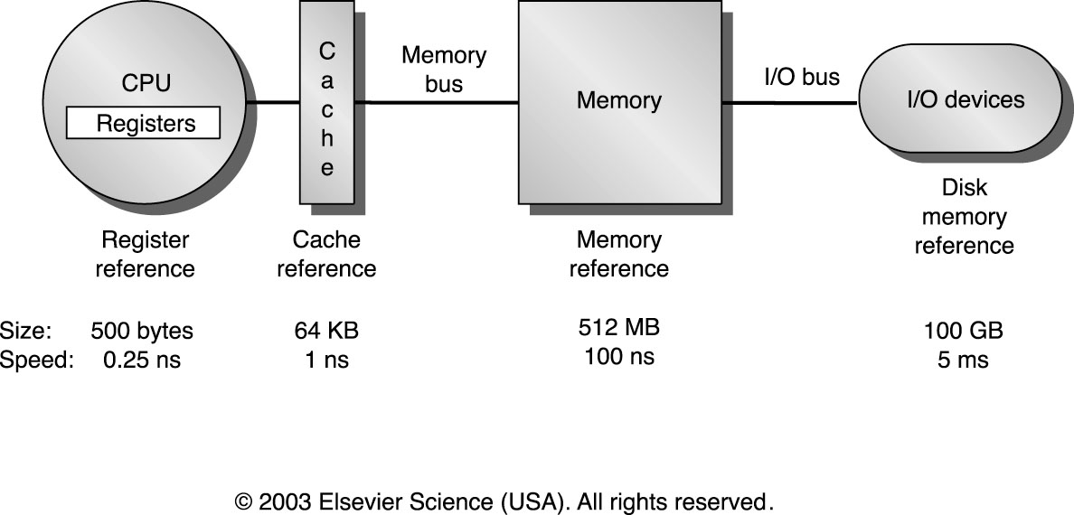
Memory Hierarchy Design
Motivated by a combination of programmer's desire for unlimited fast memory and economical considerations, and based on:
  principle of locality, and
  cost/performance ratio of memory technologies (fast ←→ small, large ←→ slow),
to achieve a memory system with cost almost as low as the cheapest level of memory and speed almost as fast as the fastest level.
Hierarchy: CPU/register file (RF) → cache (C) → main memory (MM) → disk memory/I/O devices (DM)
Speed in descending order: RF > C > MM > DM
Space in ascending order: RF < C < MM < DM

Slide 4
Memory Hierarchy Design
Four Fundamental Memory Hierarchy Design Issues:
  Block placement issue: where can a block be placed in the upper level?
  Block identification issue: how is a block found if it is in the upper level?
  Block replacement issue: which block should be replaced on a miss?
  Write strategy issue: what happens on a write?

Slide 5
Fundamental Questions
Q1: Where can a block be placed in the upper level?
(Block placement)
Q2: How is a block found if it is in the upper level?
(Block identification)
Q3: Which block should be replaced on a miss?
(Block replacement)
Q4: What happens on a write?
(Write strategy)

Slide 6
Q1: Block Placement
Where can block be placed in cache?
  In one predetermined place - direct-mapped
    Use part of address to calculate block location in cache
    Compare cache block with tag to check if block present
  Anywhere in cache - fully associative
    Compare tag to every block in cache
  In a limited set of places - set-associative
    Use portion of address to calculate set (like direct-mapped)
    Place in any block in the set
    Compare tag to every block in set
    Hybrid of direct mapped and fully associative

Slide 7
Direct Mapped Block Placement
Cache
*0
*4
*8
*C
address maps to block:
location = (block address MOD # blocks in cache)
00
04
08
0C
10
14
18
1C
20
24
28
2C
30
34
38
3C
40
44
48
4C
Memory

Slide 8
Example: Accessing A Direct-Mapped Cache
DM cache contains 4 1-word blocks. Find the # Misses for each cache given this sequence of memory block accesses: 0, 8, 0, 6, 8
DM Memory Access 1: Mapping: 0 modulo 4 = 0
Mem Block | DM Hit/Miss
0
Block 0
Block 1
Block 2
Block 3

Slide 9
Example: Accessing A Direct-Mapped Cache
DM cache contains 4 1-word blocks. Find the # Misses for each cache given this sequence of memory block accesses: 0, 8, 0, 6, 8
DM Memory Access 1: Mapping: 0 mod 4 = 0
Mem Block | DM Hit/Miss
0 | miss
Block 0 | Mem[0]
Block 1
Block 2
Block 3
Set 0 is empty: write Mem[0]

Slide 10
Example: Accessing A Direct-Mapped Cache
DM cache contains 4 1-word blocks. Find the # Misses for each cache given this sequence of memory block accesses: 0, 8, 0, 6, 8
DM Memory Access 2: Mapping: 8 mod 4 = 0
Mem Block | DM Hit/Miss
0 | miss
8
Block 0 | Mem[0]
Block 1
Block 2
Block 3

Slide 11
Example: Accessing A Direct-Mapped Cache
DM cache contains 4 1-word blocks. Find the # Misses for each cache given this sequence of memory block accesses: 0, 8, 0, 6, 8
DM Memory Access 2: Mapping: 8 mod 4 = 0
Mem Block | DM Hit/Miss
0 | miss
8 | miss
Block 0 | Mem[8]
Block 1
Block 2
Block 3
Set 0 contains Mem[0]. Overwrite with Mem[8]

Slide 12
Example: Accessing A Direct-Mapped Cache
DM cache contains 4 1-word blocks. Find the # Misses for each cache given this sequence of memory block accesses: 0, 8, 0, 6, 8
DM Memory Access 3: Mapping: 0 mod 4 = 0
Mem Block | DM Hit/Miss
0 | miss
8 | miss
0
Block 0 | Mem[8]
Block 1
Block 2
Block 3

Slide 13
Example: Accessing A Direct-Mapped Cache
DM cache contains 4 1-word blocks. Find the # Misses for each cache given this sequence of memory block accesses: 0, 8, 0, 6, 8
DM Memory Access 3: Mapping: 0 mod 4 = 0
Mem Block | DM Hit/Miss
0 | miss
8 | miss
0 | miss
Block 0 | Mem[0]
Block 1
Block 2
Block 3
Set 0 contains Mem[8]. Overwrite with Mem[0]

Slide 14
Example: Accessing A Direct-Mapped Cache
DM cache contains 4 1-word blocks. Find the # Misses for each cache given this sequence of memory block accesses: 0, 8, 0, 6, 8
DM Memory Access 4: Mapping: 6 mod 4 = 2
Mem Block | DM Hit/Miss
0 | miss
8 | miss
0 | miss
6
Block 0 | Mem[0]
Block 1
Block 2
Block 3

Slide 15
Example: Accessing A Direct-Mapped Cache
DM cache contains 4 1-word blocks. Find the # Misses for each cache given this sequence of memory block accesses: 0, 8, 0, 6, 8
DM Memory Access 4: Mapping: 6 mod 4 = 2
Mem Block | DM Hit/Miss
0 | miss
8 | miss
0 | miss
6 | miss
Block 0 | Mem[0]
Block 1
Block 2 | Mem[6]
Block 3
Set 2 empty. Write Mem[6]

Slide 16
Example: Accessing A Direct-Mapped Cache
DM cache contains 4 1-word blocks. Find the # Misses for each cache given this sequence of memory block accesses: 0, 8, 0, 6, 8
DM Memory Access 5: Mapping: 8 mod 4 = 0
Mem Block | DM Hit/Miss
0 | miss
8 | miss
0 | miss
6 | miss
8
Block 0 | Mem[0]
Block 1
Block 2 | Mem[6]
Block 3

Slide 17
Example: Accessing A Direct-Mapped Cache
DM cache contains 4 1-word blocks. Find the # Misses for each cache given this sequence of memory block accesses: 0, 8, 0, 6, 8
DM Memory Access 5: Mapping: 8 mod 4 = 0
Mem Block | DM Hit/Miss
0 | miss
8 | miss
0 | miss
6 | miss
8 | miss
Block 0 | Mem[8]
Block 1
Block 2 | Mem[6]
Block 3
Set 0 contains Mem[0]. Overwrite with Mem[8]

Slide 18
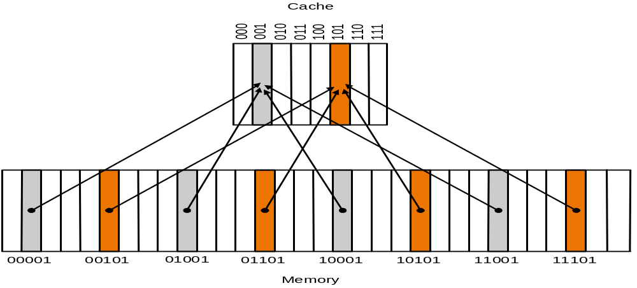
Direct-Mapped Cache with n one-word blocks
Pros: find data fast
Con: What if access 00001 and 10001 repeatedly?
→ We always miss…

Slide 19
Fully Associative Block Placement
Cache
arbitrary block mapping
location = any
00
04
08
0C
10
14
18
1C
20
24
28
2C
30
34
38
3C
40
44
48
4C
Memory

Slide 20
Example: Accessing A Fully-Associative Cache
Fully-Associative cache contains 4 1-word blocks. Find the # Misses for each cache given this sequence of memory block accesses: 0, 8, 0, 6, 8
FA Memory Access 1:
Mem Block | DM Hit/Miss
0
S e t 0
FA Block Replacement Rule: replace least recently used block in set

Slide 21
Example: Accessing A Fully-Associative Cache
Fully-Associative cache contains 4 1-word blocks. Find the # Misses for each cache given this sequence of memory block accesses: 0, 8, 0, 6, 8
FA Memory Access 1:
Mem Block | DM Hit/Miss
0 | miss
S e t 0 | Mem [0]
Set 0 is empty: write Mem[0] to Block 0

Slide 22
Example: Accessing A Fully-Associative Cache
Fully-Associative cache contains 4 1-word blocks. Find the # Misses for each cache given this sequence of memory block accesses: 0, 8, 0, 6, 8
FA Memory Access 2:
Mem Block | DM Hit/Miss
0 | miss
8
S e t 0 | Mem [0]

Slide 23
Example: Accessing A Fully-Associative Cache
Fully-Associative cache contains 4 1-word blocks. Find the # Misses for each cache given this sequence of memory block accesses: 0, 8, 0, 6, 8
FA Memory Access 2:
Mem Block | DM Hit/Miss
0 | miss
8 | miss
S e t 0 | Mem [0] | Mem [8]
Blocks 1-3 are LRU: write Mem[8] to Block 1

Slide 24
Example: Accessing A Fully-Associative Cache
Fully-Associative cache contains 4 1-word blocks. Find the # Misses for each cache given this sequence of memory block accesses: 0, 8, 0, 6, 8
FA Memory Access 3:
Mem Block | DM Hit/Miss
0 | miss
8 | miss
0
S e t 0 | Mem [0] | Mem [8]

Slide 25
Example: Accessing A Fully-Associative Cache
Fully-Associative cache contains 4 1-word blocks. Find the # Misses for each cache given this sequence of memory block accesses: 0, 8, 0, 6, 8
FA Memory Access 3:
Mem Block | DM Hit/Miss
0 | miss
8 | miss
0 | hit
S e t 0 | Mem [0] | Mem [8]
Block 0 contains Mem[0]

Slide 26
Example: Accessing A Fully-Associative Cache
Fully-Associative cache contains 4 1-word blocks. Find the # Misses for each cache given this sequence of memory block accesses: 0, 8, 0, 6, 8
FA Memory Access 4:
Mem Block | DM Hit/Miss
0 | miss
8 | miss
0 | hit
6
S e t 0 | Mem [0] | Mem [8]

Slide 27
Example: Accessing A Fully-Associative Cache
Fully-Associative cache contains 4 1-word blocks. Find the # Misses for each cache given this sequence of memory block accesses: 0, 8, 0, 6, 8
FA Memory Access 4:
Mem Block | DM Hit/Miss
0 | miss
8 | miss
0 | hit
6 | miss
S e t 0 | Mem [0] | Mem [8] | Mem [6]
Blocks 2-3 are LRU : write Mem[6] to Block 2

Slide 28
Example: Accessing A Fully-Associative Cache
Fully-Associative cache contains 4 1-word blocks. Find the # Misses for each cache given this sequence of memory block accesses: 0, 8, 0, 6, 8
FA Memory Access 5:
Mem Block | DM Hit/Miss
0 | miss
8 | miss
0 | hit
6 | miss
8
S e t 0 | Mem [0] | Mem [8] | Mem [6]

Slide 29
Example: Accessing A Fully-Associative Cache
Fully-Associative cache contains 4 1-word blocks. Find the # Misses for each cache given this sequence of memory block accesses: 0, 8, 0, 6, 8
FA Memory Access 5:
Mem Block | DM Hit/Miss
0 | miss
8 | miss
0 | hit
6 | miss
8 | hit
S e t 0 | Mem [0] | Mem [8] | Mem [6]
Block 1 contains Mem[8]

Slide 30
Fully-Associative Cache Basics
1 set, n blocks: no mapping restrictions on how blocks are stored in cache: many ways, e.g. least recently used is replaced (LRU)
0…0000
0…0001
0…0010
0…0011
0…0100
0…0101
0…0110
0…0111
0…1000
0…1001
0…1010
0…1011
0…1100
0…1101
0…1110
0…1111
…
Example: 1-set, 8-block FA cache
Set 0 | Block 0 | Block 1 | Block 2 | Block 3 | Block 4 | Block 5 | Block 6 | Block 7
PRO:
CON:
Less likely to replace needed data
Must search entire cache for hit/miss

Slide 31
Set-Associative Block Placement
Cache
*0
*0
*4
*4
*8
*8
*C
*C
address maps to set:
location = (block address MOD # sets in cache)
(arbitrary location in set)
Set 0
Set 1
Set 2
Set 3
00
04
08
0C
10
14
18
1C
20
24
28
2C
30
34
38
3C
40
44
48
4C
Memory

Slide 32
Set-Associative Cache Basics
n/m sets, m blocks (m-way): blocks are mapped from memory location to a specific set in cache
Mapping: Mem Address % n/m. If n/m is
a power of 2, log2(n/m) = #low-order bits
of memory address = cache set index
0…0000 | Mem block 0
0…0001
0…0010
0…0011
0…0100
0…0101
0…0110
0…0111
0…1000 | Mem block 8
0…1001
0…1010
0…1011
0…1100
0…1101
0…1110
0…1111
…
Example: 4 set, 2-way SA cache (ADD mod 4)
Set 00 | Block 0 | Block 1
Set 01
Set 10
Set 11

Slide 33
Example: Accessing A Set-Associative Cache
2-way Set-Associative cache contains 2 sets, 2 one-word blocks each. Find the # Misses for each cache given this sequence of memory block accesses: 0, 8, 0, 6, 8
SA Memory Access 1: Mapping: 0 mod 2 = 0
Mem Block | DM Hit/Miss
0
Set 0
Set 1
SA Block Replacement Rule: replace least recently used block in set

Slide 34
Example: Accessing A Set-Associative Cache
2-way Set-Associative cache contains 2 sets, 2 one-word blocks each. Find the # Misses for each cache given this sequence of memory block accesses: 0, 8, 0, 6, 8
SA Memory Access 1: Mapping: 0 mod 2 = 0
Mem Block | DM Hit/Miss
0 | miss
Set 0 | Mem[0]
Set 1
Set 0 is empty: write Mem[0] to Block 0

Slide 35
Example: Accessing A Set-Associative Cache
2-way Set-Associative cache contains 2 sets, 2 one-word blocks each. Find the # Misses for each cache given this sequence of memory block accesses: 0, 8, 0, 6, 8
SA Memory Access 2: Mapping: 8 mod 2 = 0
Mem Block | DM Hit/Miss
0 | miss
8
Set 0 | Mem[0]
Set 1

Slide 36
Example: Accessing A Set-Associative Cache
2-way Set-Associative cache contains 2 sets, 2 one-word blocks each. Find the # Misses for each cache given this sequence of memory block accesses: 0, 8, 0, 6, 8
SA Memory Access 2: Mapping: 8 mod 2 = 0
Mem Block | DM Hit/Miss
0 | miss
8 | miss
Set 0 | Mem[0] | Mem[8]
Set 1
Set 0, Block 1 is LRU: write Mem[8]

Slide 37
Example: Accessing A Set-Associative Cache
2-way Set-Associative cache contains 2 sets, 2 one-word blocks each. Find the # Misses for each cache given this sequence of memory block accesses: 0, 8, 0, 6, 8
SA Memory Access 3: Mapping: 0 mod 2 = 0
Mem Block | DM Hit/Miss
0 | miss
8 | miss
0
Set 0 | Mem[0] | Mem[8]
Set 1

Slide 38
Example: Accessing A Set-Associative Cache
2-way Set-Associative cache contains 2 sets, 2 one-word blocks each. Find the # Misses for each cache given this sequence of memory block accesses: 0, 8, 0, 6, 8
SA Memory Access 3: Mapping: 0 mod 2 = 0
Mem Block | DM Hit/Miss
0 | miss
8 | miss
0 | hit
Set 0 | Mem[0] | Mem[8]
Set 1
Set 0, Block 0 contains Mem[0]

Slide 39
Example: Accessing A Set-Associative Cache
2-way Set-Associative cache contains 2 sets, 2 one-word blocks each. Find the # Misses for each cache given this sequence of memory block accesses: 0, 8, 0, 6, 8
SA Memory Access 4: Mapping: 6 mod 2 = 0
Mem Block | DM Hit/Miss
0 | miss
8 | miss
0 | hit
6
Set 0 | Mem[0] | Mem[8]
Set 1

Slide 40
Example: Accessing A Set-Associative Cache
2-way Set-Associative cache contains 2 sets, 2 one-word blocks each. Find the # Misses for each cache given this sequence of memory block accesses: 0, 8, 0, 6, 8
SA Memory Access 4: Mapping: 6 mod 2 = 0
Mem Block | DM Hit/Miss
0 | miss
8 | miss
0 | hit
6 | miss
Set 0 | Mem[0] | Mem[6]
Set 1
Set 0, Block 1 is LRU: overwrite with Mem[6]

Slide 41
Example: Accessing A Set-Associative Cache
2-way Set-Associative cache contains 2 sets, 2 one-word blocks each. Find the # Misses for each cache given this sequence of memory block accesses: 0, 8, 0, 6, 8
SA Memory Access 5: Mapping: 8 mod 2 = 0
Mem Block | DM Hit/Miss
0 | miss
8 | miss
0 | hit
6 | miss
8
Set 0 | Mem[0] | Mem[6]
Set 1

Slide 42
Example: Accessing A Set-Associative Cache
2-way Set-Associative cache contains 2 sets, 2 one-word blocks each. Find the # Misses for each cache given this sequence of memory block accesses: 0, 8, 0, 6, 8
SA Memory Access 5: Mapping: 8 mod 2 = 0
Mem Block | DM Hit/Miss
0 | miss
8 | miss
0 | hit
6 | miss
8 | miss
Set 0 | Mem[8] | Mem[6]
Set 1
Set 0, Block 0 is LRU: overwrite with Mem[8]

Slide 43
Set-Associative Cache Basics
n/m sets, m blocks (m-way): blocks are mapped from memory location to a specific set in cache
Mapping: Mem Address % n/m. If n/m is
a power of 2, log2(n/m) = #low-order bits
of memory address = cache set index
0…0000 | Mem block 0
0…0001
0…0010
0…0011
0…0100
0…0101
0…0110
0…0111
0…1000 | Mem block 8
0…1001
0…1010
0…1011
0…1100
0…1101
0…1110
0…1111
…
Example: 4 set, 2-way SA cache (X mod 4)
PRO:
Set 00 | Block 0 | Block 1
Set 01
Set 10
Set 11
Easier to find but won’t always overwrite
Must search set for hit/miss
CON:

Slide 44
Associativity Considerations
DM and FA are special cases of SA cache
  Set-Associative: n/m sets; m blocks/set (associativity=m)
  Direct-Mapped: m=1 (1-way set-associative, associativity=1)
  Fully-Associative: m=n (n-way set-associative, associativity=n)
Advantage of Associativity: as associativity increases, miss rate decreases (because more blocks per set that we’re less likely to overwrite)
Disadvantage of Associativity: as associativity increases, hit time increases (because we have to search more blocks – more HW required)
Block Replacement: LRU or random. Random is easier to implement and often not much worse

Slide 45
Q2: Block Identification
Every cache block has an address tag that identifies its location in memory
Hit when tag and address of desired word match
(comparison by hardware)
Q: What happens when a cache block is empty?
A: Mark this condition with a valid bit (0 if empty- 0 if the data is not in the cache otherwise 1)
Valid
Tag
Data
1
0x00001C0
0xff083c2d

Slide 46
Q2: Block Identification?
Tag on each block
  No need to check index or block offset
Increasing associativity shrinks index, expands tag
Block Address
Block Offset
Tag
Index
Fully Associative: No index
Direct Mapped: Large index

Slide 47
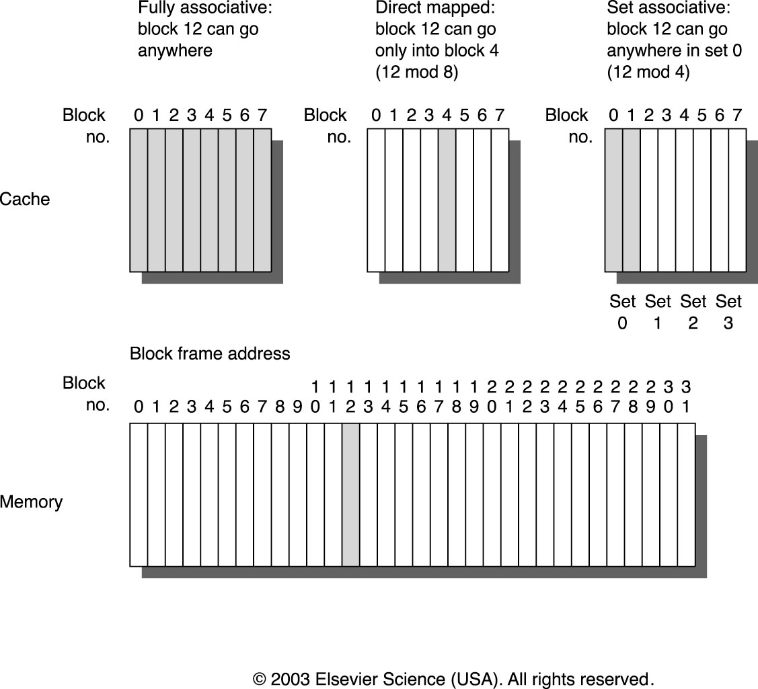
Memory Hierarchy Design
Placement: three approaches:
  fully associative: any block in the main memory can be placed in any block frame. It is flexible but expensive due to associativity
  direct mapping: each block in memory is placed in a fixed block frame with the following mapping function: (Block Address) MOD (Number of blocks in cache)
  set associative: a compromise between fully associative and direct mapping; The cache is divided into sets of block frames, and each block from the memory is first mapped to a fixed set wherein the block can be placed in any block frame. Mapping to a set follows the function, called a bit selection:
  (Block Address) MOD (Number of sets in cache)

Slide 48
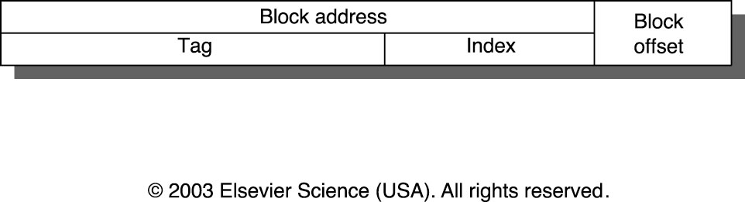
Memory Hierarchy Design
Identification:
  Each block frame in the cache has an address tag indicating the block's address in the memory
  All possible tags are searched in parallel
  A valid bit is attached to the tag to indicate whether the block contains valid information or not
  An address for a datum from CPU, A, is divided into a block address field and a block offset field:
    block address = (A) / (block size)
    block offset = (A) MOD (block size)
  block address is further divided into tag and index:
    index indicates the set in which the block may reside
    tag is compared to indicate a hit or a miss

Slide 49
Memory Hierarchy Design
Replacement on a cache miss:
  The more choices for replacement, the more expensive for hardware → direct mapping is the simplest
  Random vs. least-recently used (LRU): the former has uniform allocation and is simple to build while the latter can take advantage of temporal locality but can be expensive to implement (why?). First in, first out (FIFO) approximates LRU and is simpler than LRU
  Data cache misses per 1000 instructions
 | Associativity
 | Two-way |  |  | Four-way |  |  | Eight-way
Size | LUR | Random | FIFO | LUR | Random | FIFO | LUR | Random | FIFO
16K | 114.1 | 117.3 | 115.5 | 111.7 | 115.1 | 113.3 | 109.0 | 111.8 | 110.4
64K | 103.4 | 104.3 | 103.9 | 102.4 | 102.3 | 103.1 | 99.7 | 100.5 | 100.3
256K | 92.2 | 92.1 | 92.5 | 92.1 | 92.1 | 92.5 | 92.1 | 92.1 | 92.5

Slide 50
Memory Hierarchy Design
Write strategies:
  Most cache accesses are reads: 10% stores + 37% loads + 100% instructions → only 7% of all memory accesses are writes
  Optimize reads to make the common case fast, observing that CPU doesn't have to wait for writes while must wait for reads: fortunately, read is easy in direct-mapping: reading and tag comparison can be done in parallel (what about associative mapping?); but write is hard:
    Cannot overlap tag reading and block writing (destructive)
    CPU specifies write size: only 1 - 8 bytes. Thus write strategies often distinguish cache design; On a write hit:
      write through (or store through):
        ensuring consistency at the cost of memory and bus bandwidth
        write stalls may be alleviated by using write buffers
      write back (store in):
        minimizing memory and bus traffic at the cost of weakened consistency,
        use dirty bit to indicate modification
        read misses may result in writes (why?)
    On a write miss:
      write allocate (fetch on write)
      no-write allocate (write around)

Slide 51
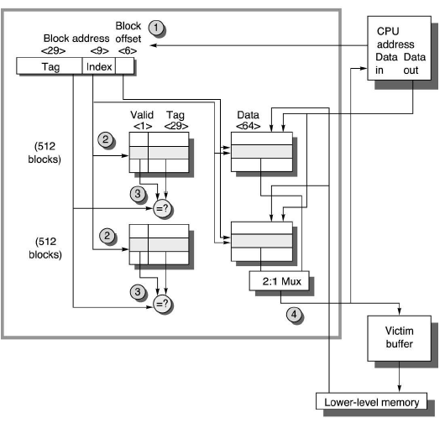


Memory Hierarchy Design
An Example:The Alpha 21264 Data Cache
  Cache size=64KB, block size=64B, two-way set associativity, write-back, write allocate on a write miss.
  What is the index size?
  = 64K/(64*2) = 2¹⁶/(2⁶⁺¹)=2⁹

